Slide 1

2017 NASAA Enforcement Forum
Keith Woodwell, Chair (UT)
Joe Rotunda, Vice-Chair (TX)
Greg Strong (DE)
Jesse Devine (NY)
Jake van der Laan (NB)
Jason Roy (MB)

Slide 2
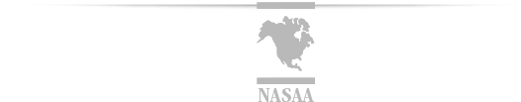
Forum Outline
Statistical Data From 2017 Survey
Enforcement Coordination Among Regulators
Exploitation of Senior Investors
Threats from Emerging Financial Technologies
Focus on Bad Actors in the Industry
Canadian Enforcement Statistics

Slide 3
The Report Basics
50 jurisdictions responded to the survey.
  Numbers/statistics are undercounted.
  Data shows NASAA members on the front lines in protecting Main Street investors.
  Poll members to predict new and upcoming threats.

Slide 4
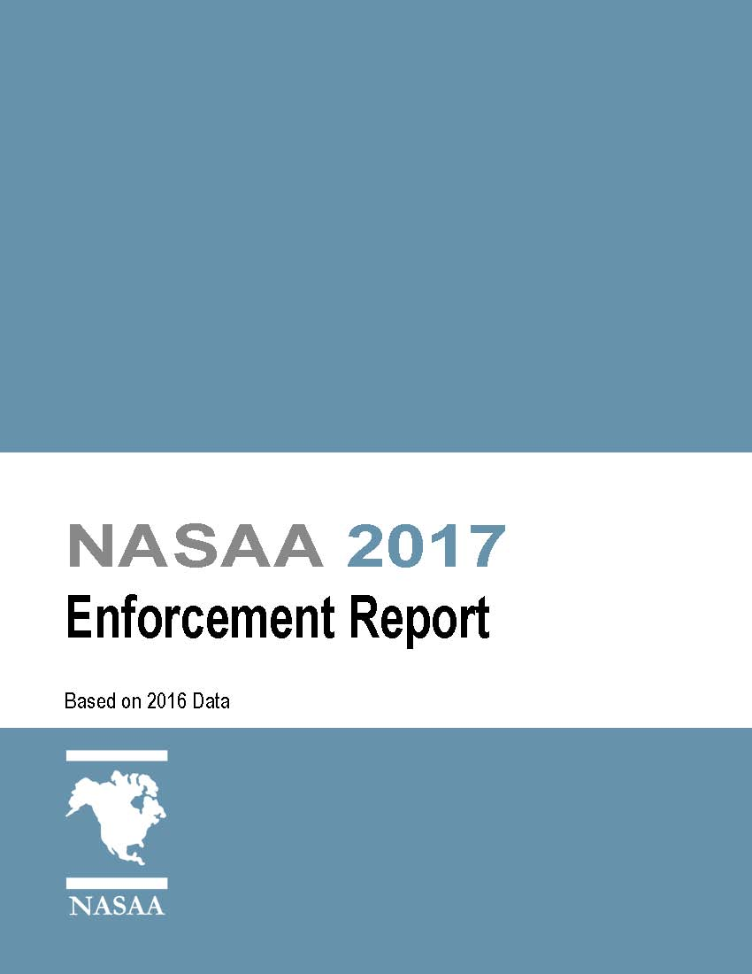

Slide 6
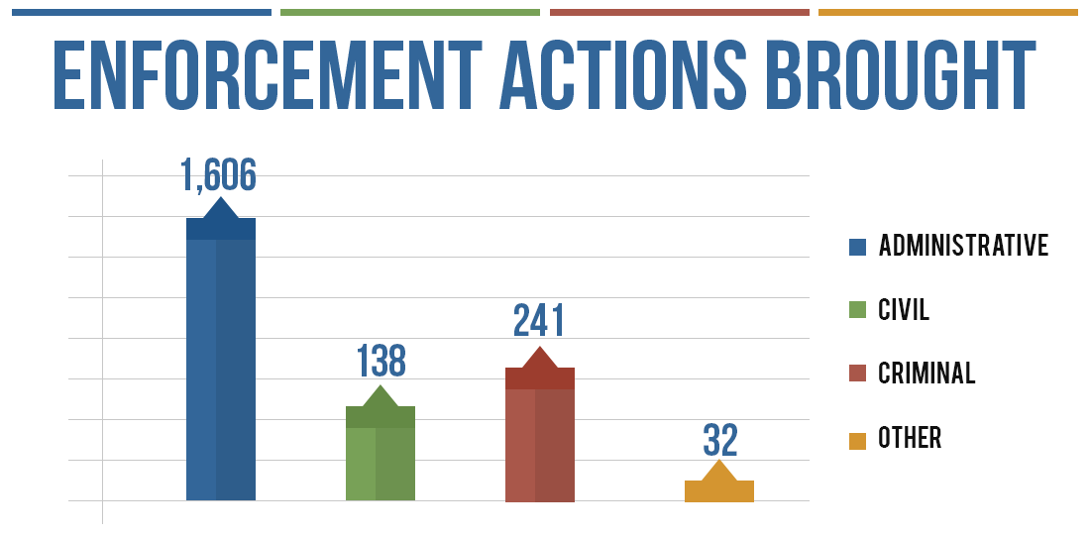

Slide 7
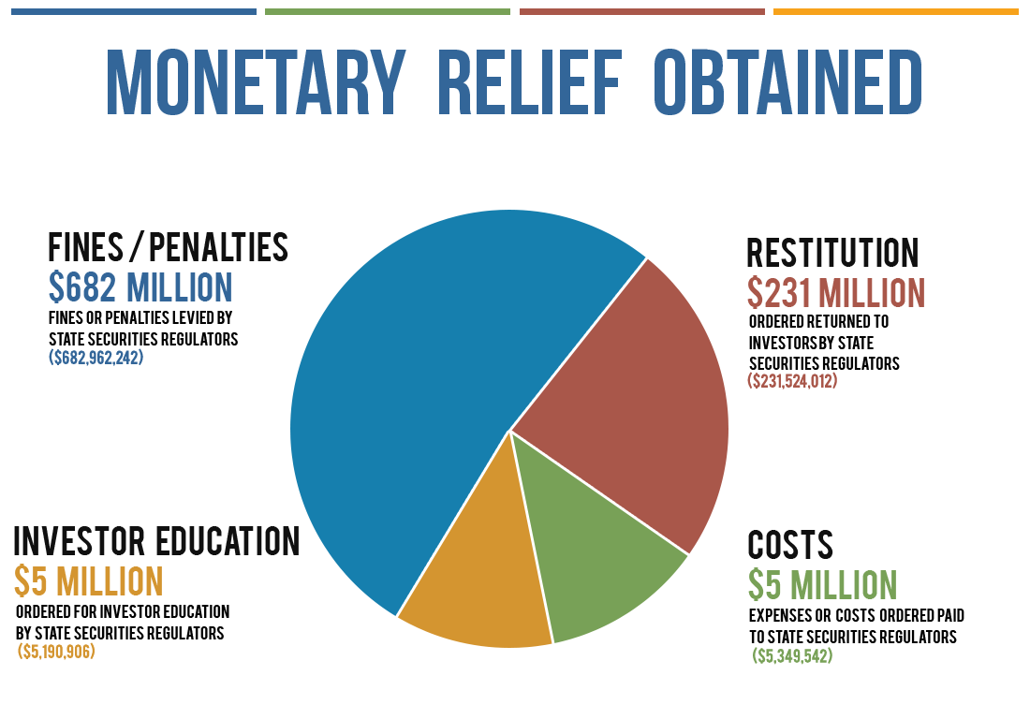

Slide 8
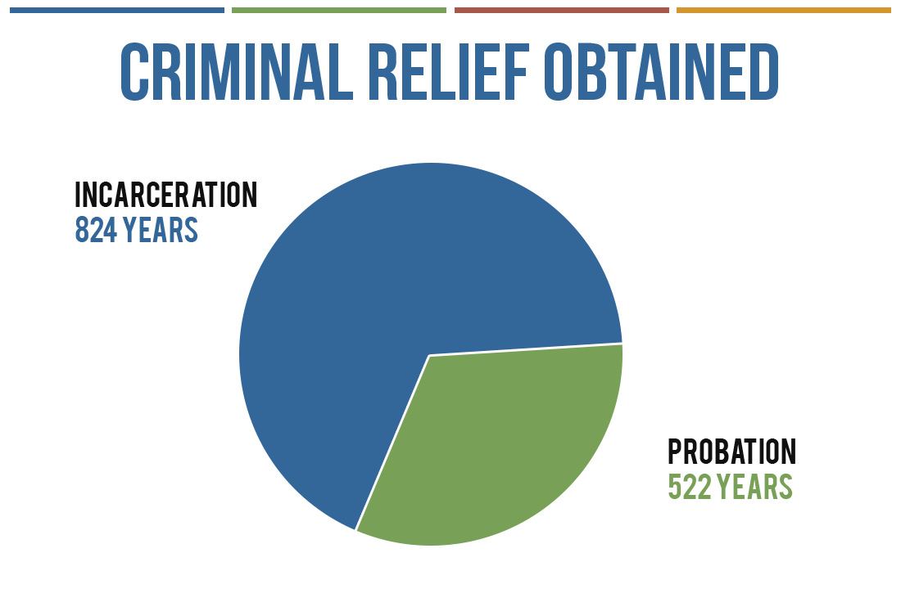

Slide 9
MOST REPORTED PRODUCTS AND SCHEMES In order of frequency of investigations reported by states
1 | Oil & Gas Investment Programs
2 | Stocks and Similar Equities
3 | Real Estate Investment Programs
4 | Promissory Notes
5 | Internet/Social Media Fraud

Slide 10
ENFORCEMENT COORDINATION
AMONG STATE AND FEDERAL SECURITIES REGULATORS
State and federal regulators continue to recognize that coordinated efforts lead to efficient enforcement.
In many regions, state and federal regulators are scheduling regular meetings where they can share important information about their work and coordinate their actions.
In other situations, agencies are sharing evidence, jointly investigating illegal and fraudulent securities offerings and referring cases for administrative, civil or criminal enforcement actions.
In some situations, state investigators work closely with federal law enforcement agencies as part of an ongoing task force dedicated to leveraging limited resources with expertise to more effectively investigate fraudulent schemes.

Slide 11
CASE REFERRALS
TOTAL NUMBER OF CASES REFERRED, FORWARDED OR PROVIDED TO OR RECEIVED FROM ANOTHER AGENCY
Number of cases referred, forwarded or provided to or received from another agency.

Slide 12
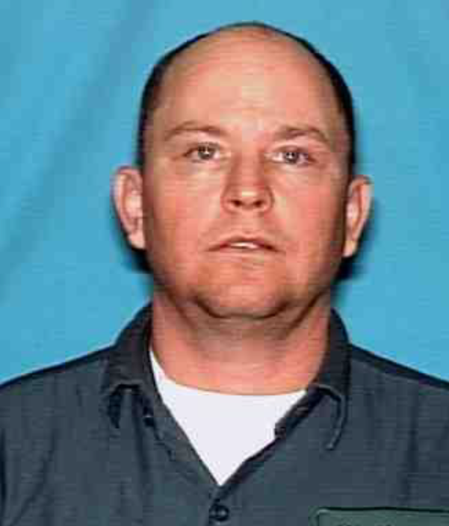
UNITED STATES OF AMERICA V. WILLIAM ALLEN RISINGER
CAUSE NO. 1:15-cr-00140-SS, in The United States District Court For the Western District of Texas
The Texas State Securities Board regularly conducts joint investigations with the Federal Bureau of Investigation.
The agency’s investigators routinely work at the offices of the Federal Bureau of Investigation and collaborate with federal law enforcement agents.
A financial examiner employed by the agency and agents from the Federal Bureau of Investigation recently worked together to put together a criminal case against William Allen Risinger, a local promoter of a fraudulent oil and gas scheme.

Slide 13
UNITED STATES OF AMERICA V. WILLIAM ALLEN RISINGER
CAUSE NO. 1:15-cr-00140-SS, in The United States District Court For the Western District of Texas
The joint investigation revealed that Mr. Risinger unlawfully raised $4.5 million from investors and used that money to fuel a ponzi scheme, whereby returns paid to prior investors were derived from funds tendered by new investors.
The investigator from the Texas State Securities Board and agents from the Federal Bureau of Investigation provided their findings to the Untied States Attorney’s Office, and federal prosecutors secured an indictment charging Mr. Risinger with three counts of wire fraud and other federal crimes.

Slide 14
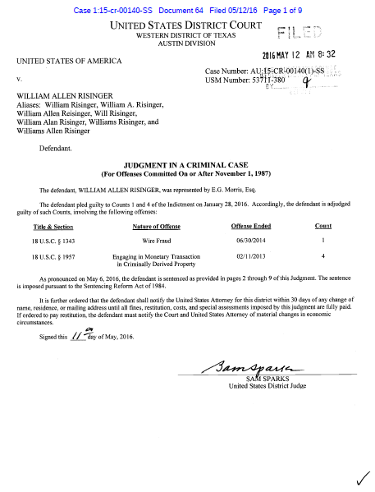
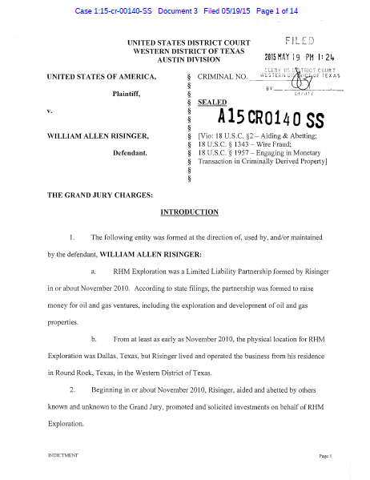
Risinger made false and fraudulent promises, representations, material omissions and pretenses in connection with each of these investment programs in order to obtain money for his own personal use and benefit. Risinger engaged in a single overarching scheme to defraud by obtaining, using, and commingling monies acquired by false and fraudulent pretenses among all of the investment vehicles.
Indictment Filed 2015 May 19

Slide 15
It was part of the scheme and artifice that Risinger fraudulently acquired cash and assets for the following purposes:
to apply to the personal use and benefit of Risinger and his family;
to maintain an ongoing or expanding Ponzi scheme in which the “returns” paid to earlier investors actually constituted funds provided by later investors; and
to make payments and/or fund distributions to some investors so as to lull investors into the mistaken belief that their investment remained sound.
Indictment Filed 2015 May 19

Slide 16
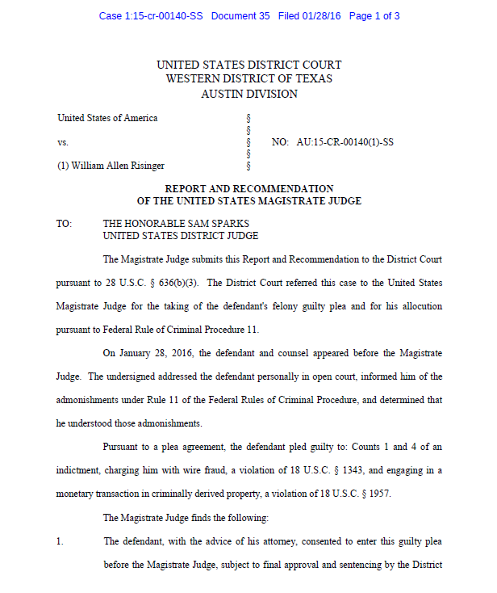
Pursuant to a plea agreement, the defendant pled guilty to: Counts 1 and 4 of an indictment, charging him with wire fraud, a violation of 18 U.S.C. § 1343, and engaging in a monetary transaction in criminally derived property, a violation of 18 U.S.C. § 1957.
Report and Recommendation 2016 January 28

Slide 17
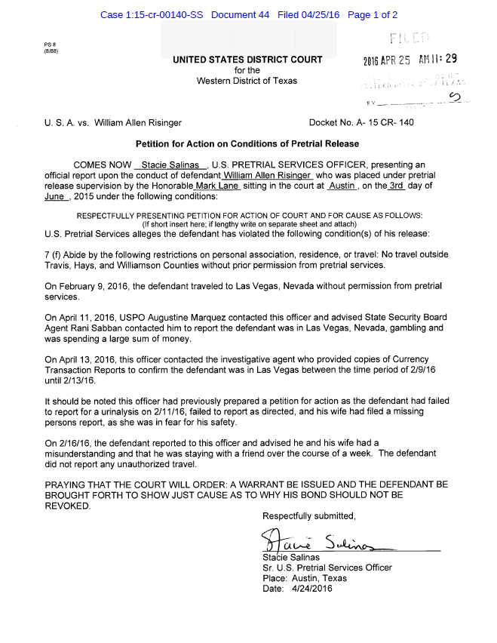
U.S. Pretrial Services alleges the defendant has violated the following condition(s) of his release: 7(f) Abide by the following restrictions on personal association, residence or travel: No travel outside Travis, Hays and Williamson Counties without prior permission from pretrial services.
On April 11, 2016, USPO Augustine Marquez contacted this officer and advised State Security Board Agent Rani Sabban contacted him to report the defendant was in Las Vegas, Nevada, gambling and was spending a large sum of money.
Petition to Action/Arrest Filed 2016 April 25

Slide 18
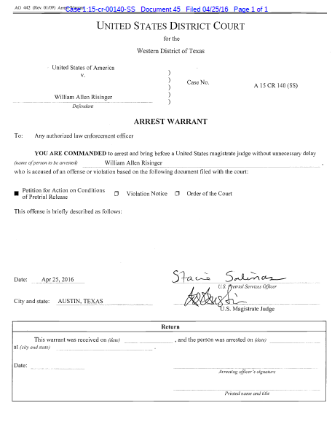
YOU ARE COMMANDED to arrest and bring before a United States magistrate judge without unnecessary delay William Allen Risinger, who is accused of an offense or violation based on the following document filed with the court: Petition for Action on Conditions of Pretrial Release.
Arrest Warrant Entered 2016 April 25

Slide 19
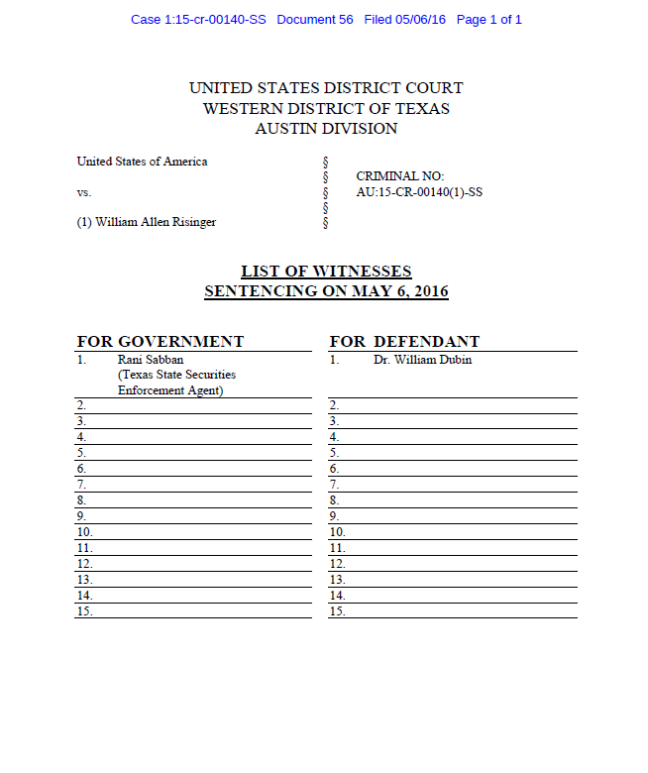
LIST OF WITNESSES SENTENCING ON MAY 6, 2016, FOR THE GOVERNMENT: Rani Sabban (Texas State Securities Enforcement Agent)
Witness List On Sentencing Filed 2016 May 05

Slide 20
The defendant is hereby committed to the custody of the Federal Bureau of Prisons to be imprisoned for a total term of ONE HUNDRED SIXTY (160) MONTHS AS TO COUNT ONE and ONE HUNDRED TWENTY (120) MONTHS AS TO COUNT FOUR, with both terms to run concurrent to each other.
Judgment In A Criminal Case Filed 2016 May 12

Slide 21
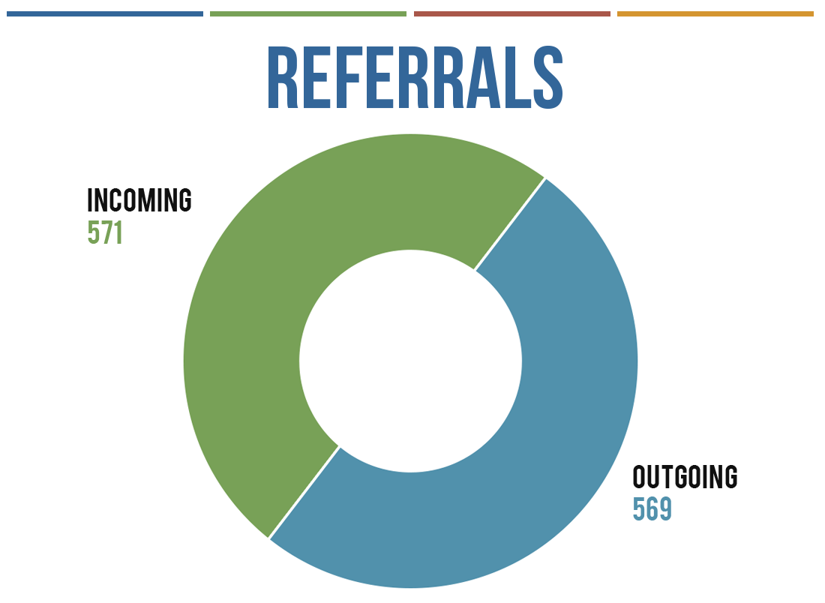
Enforcement Coordination Among Regulators

Slide 22
Continued Exploitation of Vulnerable Senior Investors
Increasing awareness and identifying issues
Vigorous enforcement
What the data tells us

Slide 23
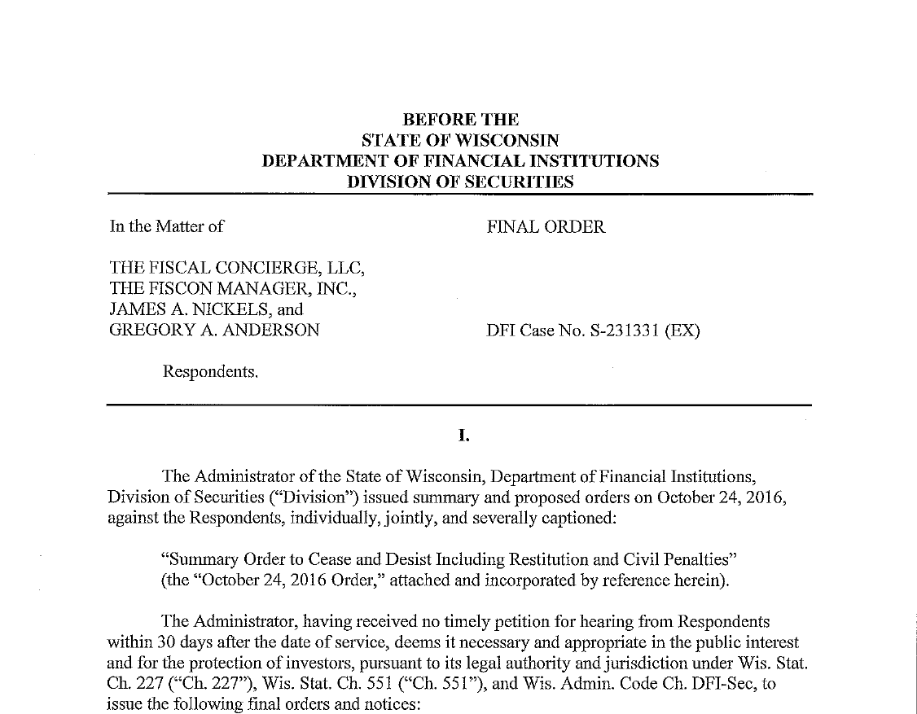
Continued Exploitation of Vulnerable Senior Investors
Fiscal Concierge and James Nickels
$4 Million Promissory Note Ponzi Scheme
Targeting Senior Investors and Long Time Friends
Prior Disciplinary History
Misrepresentations to Induce Investments
Ordered to Cease and Desist, Make Restitution and Pay significant Civil Penalties
Criminal Referral Ongoing

Slide 24
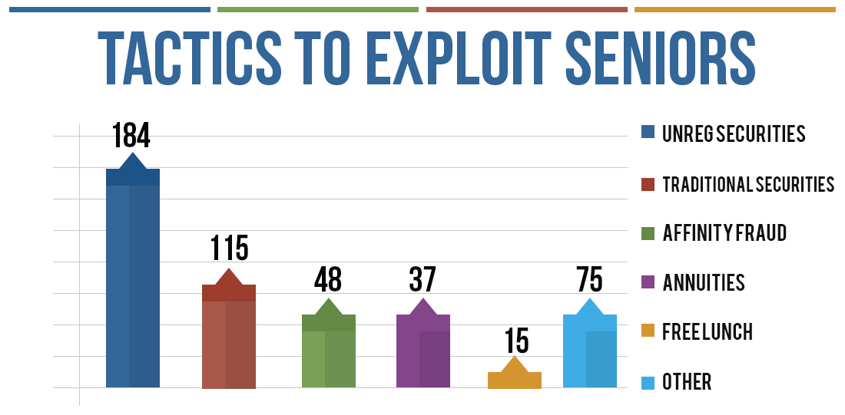
Continued Exploitation of Vulnerable Senior Investors

Slide 25
Investor Threats Stemming from Emerging Financial Technologies
Binary Options
Cryptocurrencies, ICO’s and Cryptotrading

Slide 26
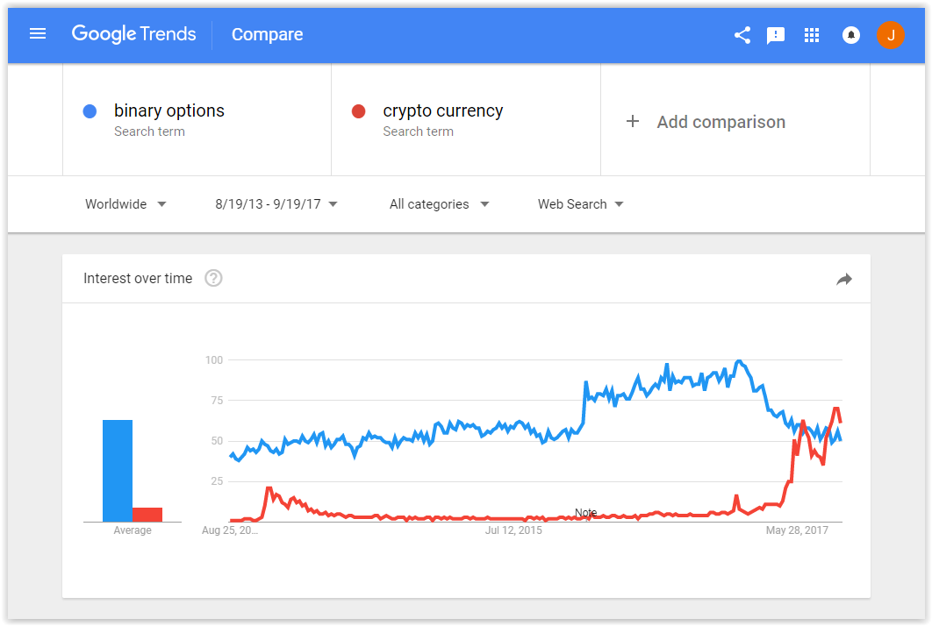

Slide 27

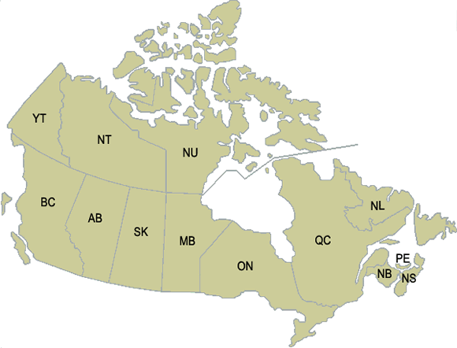
THE CSA BINARY OPTIONS TASK FORCE

Slide 28
EVOLUTION OF THE BINARY OPTIONS SCAM
2013 - 2014 A FEW COMPLAINTS
2015 A FEW MORE COMPLAINTS
2016 DRAMATIC INCREASE IN COMPLAINTS
EARLY IN 2016.
2016 CSA INVESTOR ALERT - MARCH 23/16.
2016 800+ COMPLAINTS IN CANADA.
2015 - 2017 CSA JURISDICTIONS ISSUE 260 ALERTS, WARNINGS & CAUTIONS.

Slide 29
THE WORLD’S BIGGEST INVESTMENT SCAM?
EARNING FRAUDSTERS $10 BILLION / YEAR
TECHNOLOGY USED TO FIND INVESTORS LIKE NEVER BEFORE.
ADVERTISING VIA SOCIAL MEDIA AND AFFILIATE MARKETING.
PLATFORM PROVIDERS SELLING PRE-PACKAGED SCAMS (SITES & MARKETING) FOR $25,000.
HUNDREDS OF BINARY OPTIONS SITES CREATED & TARGETING INVESTORS ALL OVER THE WORLD.
6,427 “BINARY” (.COM, .ORG or .NET) DOMAINS REGISTERED FROM 2012 – 2016.

Slide 30
CSA TASK FORCE INITIATIVES
Binary Options Advertising & Marketing
Apps
Payment Processors
Coordinate with Local and Int’l Partners
Intelligence & Statistics
Multi-jurisdictional Enforcement Action
Engage Israel to Take Action
Investor Education

Slide 31
Increased Focus on Bad Actors in the Licensed Securities Industry
Enforcement Action: Roger Odell Hudspeth and Dominion Investment Advisors LLC
  Virginia Division of Securities (SEC-2014-00031)

Slide 32
Increased Focus on Bad Actors in the Licensed Securities Industry
Hudspeth recruited senior investors through free “social security seminars”
Steered clients to risky investments with promised returns up to 60%

Slide 33
Increased Focus on Bad Actors in the Licensed Securities Industry
Hudspeth failed to disclose:
  20% fees and commissions
  Personal financial interest
  Companies controlled by his associate Daryl Gene Bank, permanently barred by FINRA

Slide 34
Increased Focus on Bad Actors in the Licensed Securities Industry
2016 civil judgment: Hudspeth permanently barred, $1 million penalty/restitution
U.S. Attorney (E.D. Va.) pursuing criminal charges

Slide 35
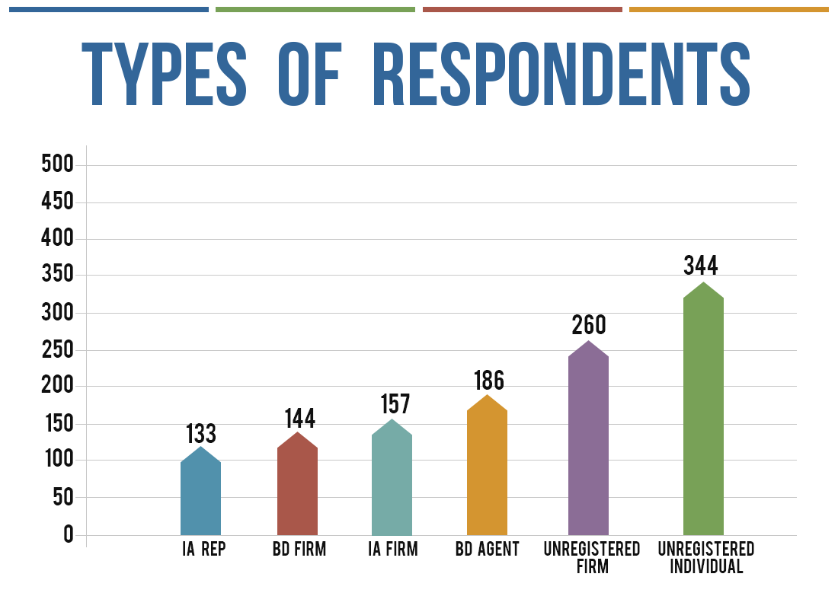
Increased Focus on Bad Actors in the Licensed Securities Industry

Slide 36
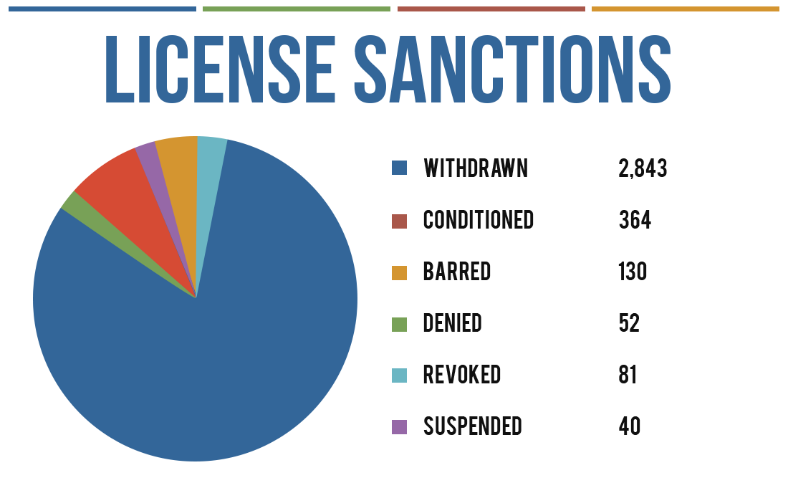
Increased Focus on Bad Actors in the Licensed Securities Industry

Slide 37
Increased Focus on Bad Actors in the Licensed Securities Industry
Looking ahead:
In 2016, states investigated 700 IA firms and representatives
31% increase from 2015

Slide 38
CSA 2016 Enforcement Report
High Level Highlights

Slide 39
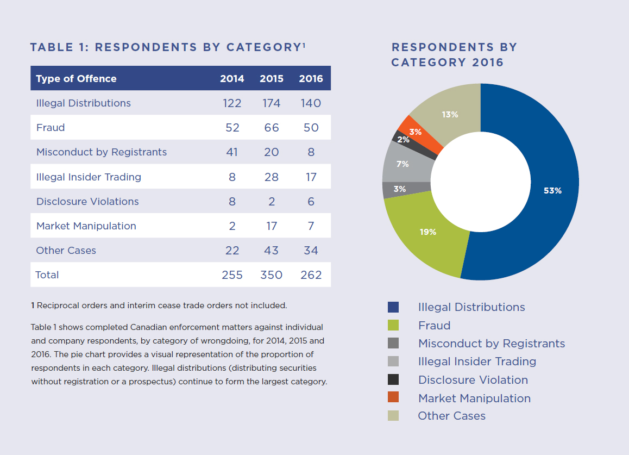

Proceedings Commenced

Slide 40

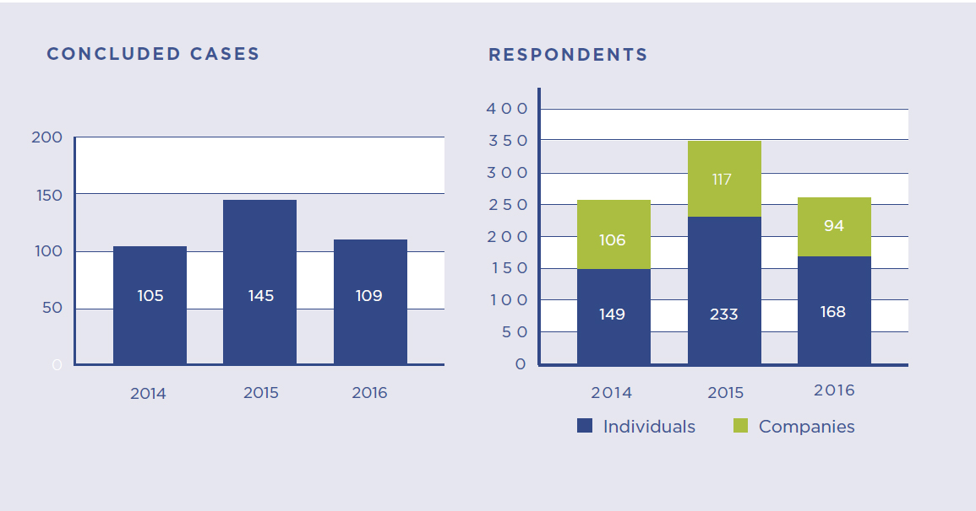
Concluded Cases

Slide 41
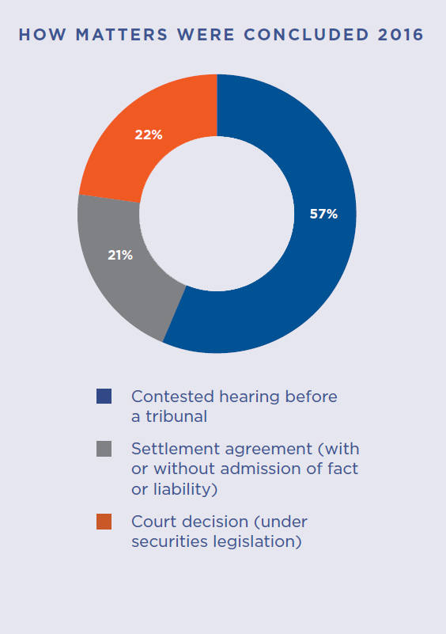
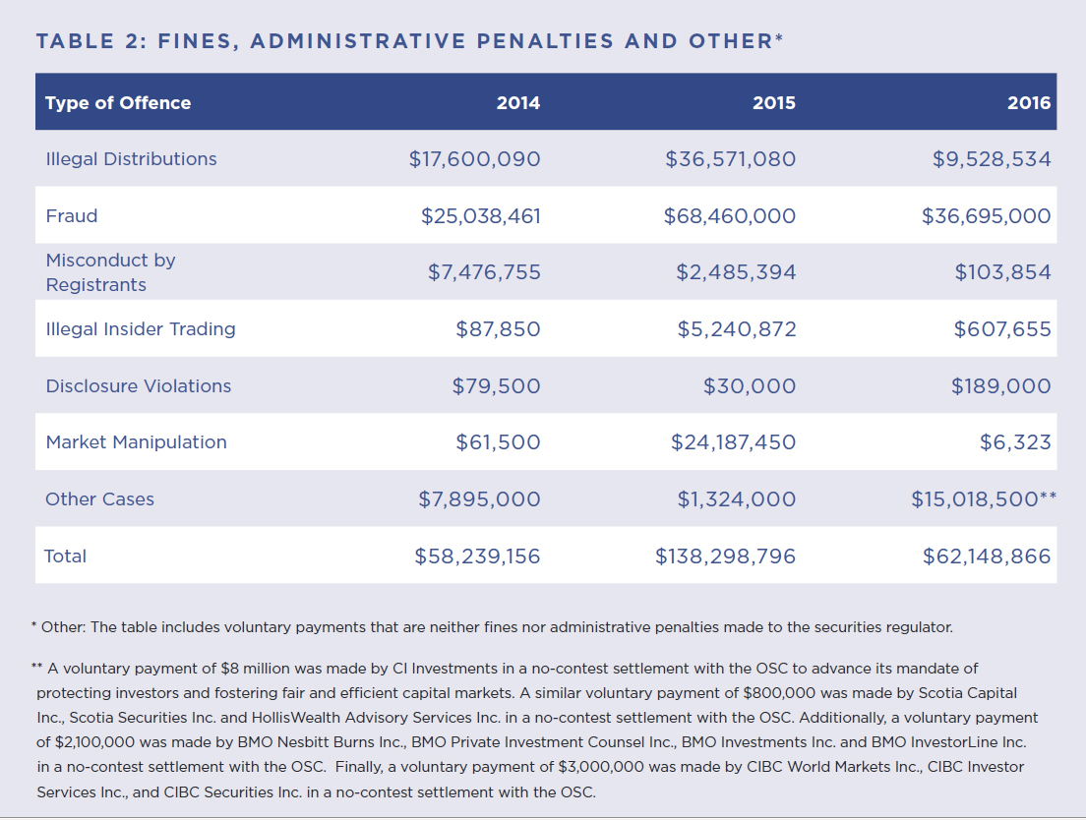
Fines and Administrative Penalties

Slide 42
2017 NASAA Enforcement Forum
Questions?

